Slide 1
50I56D-905 Integrated Intelligent Valve Retrofit Kit

Slide 2
Business and Product Overview

Slide 3
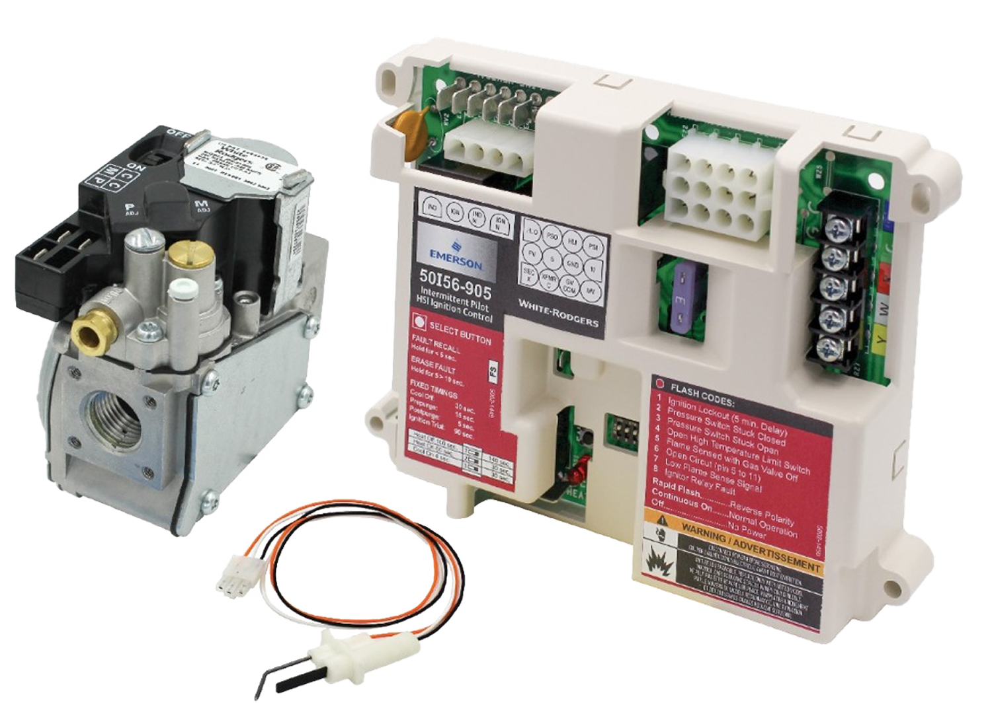
White-Rodgers Intelligent Valve Retrofit Kit
The White-Rodgers 50I56D-905 Intelligent Valve Retrofit Kit converts furnaces built with a SmartValve® and Fan Timer to operate with a standard intermittent pilot valve and integrated furnace control, and replaces over 50 first generation SmartValve® controls.
Applications:
Single Stage Gas Heat
PSC Blower Motor
Upgrade 24v HSI ignitor to 120v
Intermittent Pilot Operation
ICP & Lennox Brands
1st Gen SmartValve Retrofit
50I56D-905

Slide 4

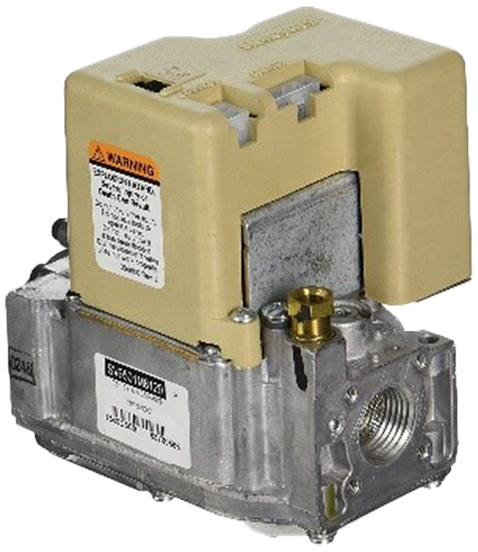
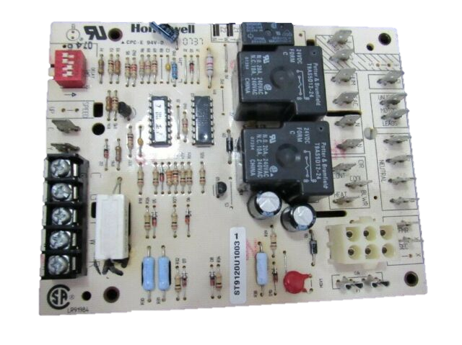
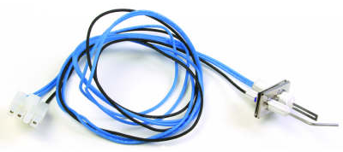
A Reliable Replacement. Simple Troubleshooting
Complicated
Simple!
24v
120v
In traditional SmartValve setups an electronic board in the SmartValve sends a signal back to the fan timer to initiate the blower operation.
Troubleshooting issues between the SmartValve and the Fan Timer has long made it consistently difficult to diagnose errors.
Now, our 50I56D-905 offers both pieces in an easy-to-understand product that eliminates difficult troubleshooting, while also upgrading the hot surface ignitor to 120v. Reliable valve with 5-year warranty.

Slide 5
Value Proposition
Our research indicates that ICP alone produced more than 3 million furnaces between 1994 and 2006, offering a significant install base for replacement parts.
In fact, we estimate there is a total install base of 5 million (first generation) SmartValve products, offering annual replacement volume of 250,000 controls, with a history of difficult diagnosis and troubleshooting that can now be eliminated with our retrofit kit.

Slide 6
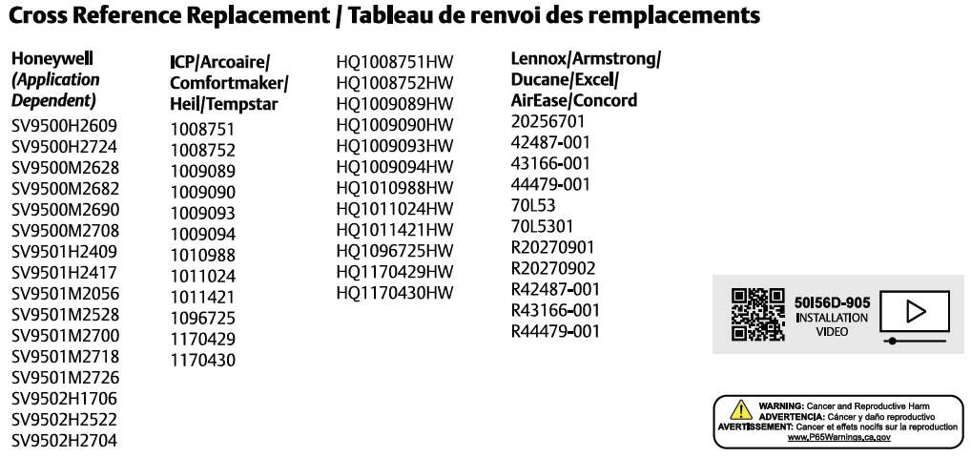
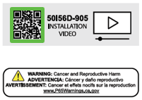
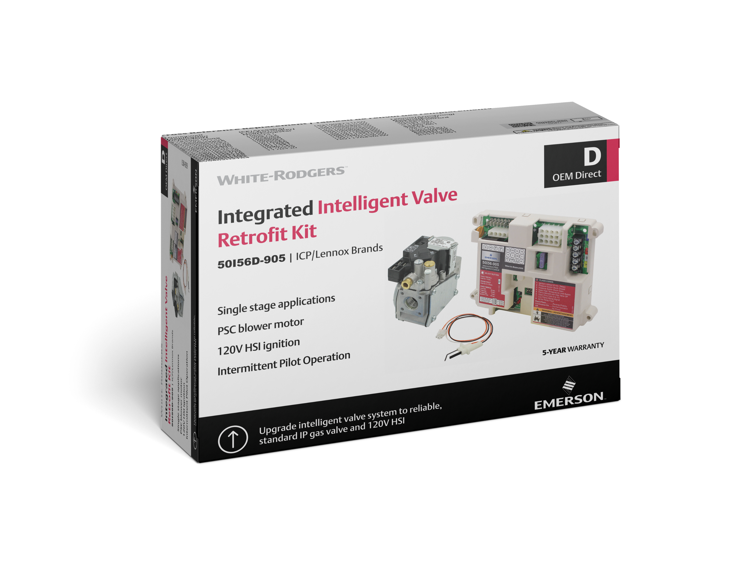



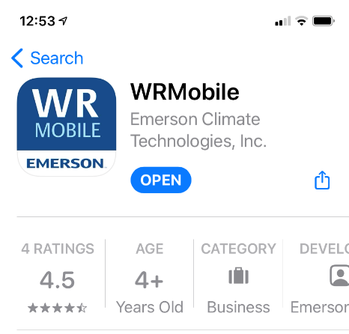
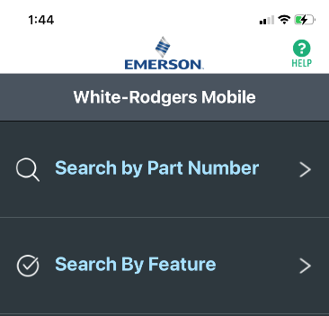



Extensive Cross-Reference Options
References are listed on the box packaging, on WR Mobile, or at our website.
To get the App:
Go to your App Store and type in WR Mobile or hold the camera over the QR code on the side of the box.
Cross Reference on the Box
Install & Open
Search by Valve Part

Slide 7
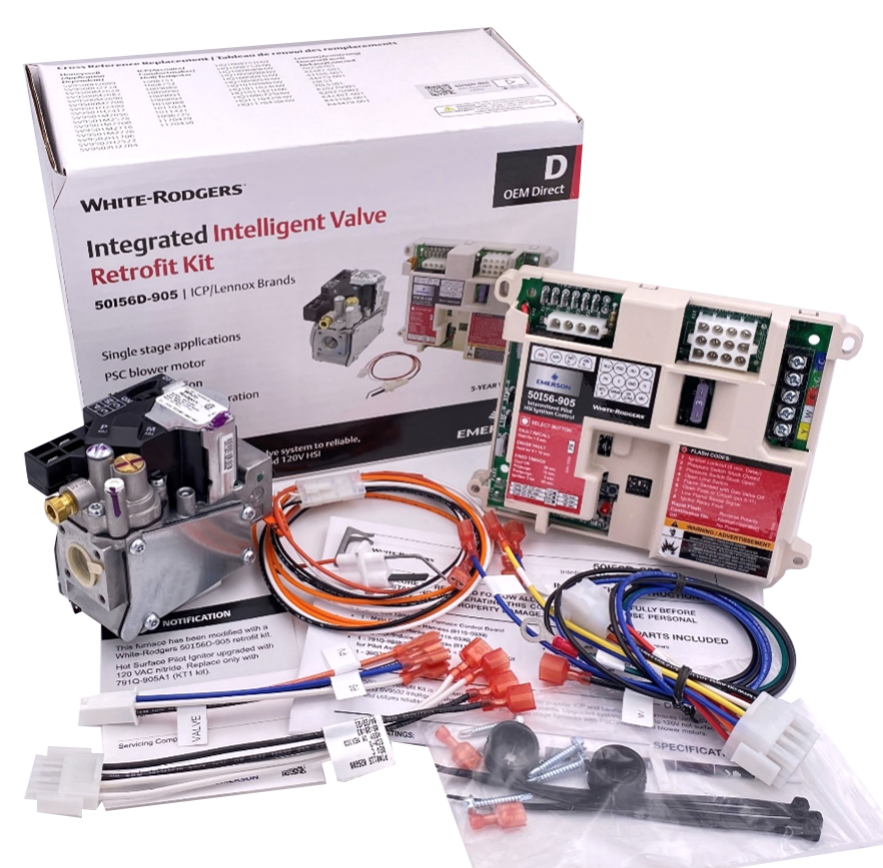
What’s in the Box?
50I56-905 120V HSI IP Furnace Control Board
1 - Main CONTROL Harness
1 - Gas VALVE Harness
1 - Ignitor/Inducer C Harness
1 - 120V Ignitor + Flame Sensor Kit for Pilot Assembly
1 - 36G33-905 IP Gas Valve w/ LP Conversion kit
4 - 1” Sheet Metal Mounting Screws
4 - Wire Ties
2 - 1/4" Female Crimp-on Spades
2 - 7/8” Sheet Metal Wire Grommets
Unit Retrofit Label
Installation Instructions
Troubleshooting Label on Control Cover
50I56D-905

Slide 8

White-Rodgers Cross Reference
Go to: www.whiterodgers.com
Hover over Tools & Resources
Click on: White-Rodgers Cross Reference/Product Information
Enter the Model Number or click on: Search Replacement Heating Controls by Major OEM Brand

Slide 9

Why Contractors Trust White-Rodgers
Industry Leading Products
Used by more OEM’s
Offering the widest range of Universal Replacement Controls
Ease of Installation
Simple, easy to understand instructions
Product Reliability
Quality Control assures reliable products
Affordable
Competitive pricing
Supported by Knowledgeable Representatives
Contractor direct phone support

Slide 10
Technical

Slide 11
White-Rodgers Intelligent Valve Retrofit Kit
The White-Rodgers 50I56D-905 Intelligent Valve Retrofit Kit converts furnaces built with a SmartValve® and Fan Timer to operate with a standard intermittent pilot valve and integrated furnace control, and replaces over 50 first generation SmartValve® controls.
Applications:
Single Stage Gas Heat
PSC Blower Motor
Upgrade 24v HSI ignitor to 120v
Intermittent Pilot Operation
ICP & Lennox Brands
1st Gen SmartValve Retrofit
50I56D-905

Slide 12
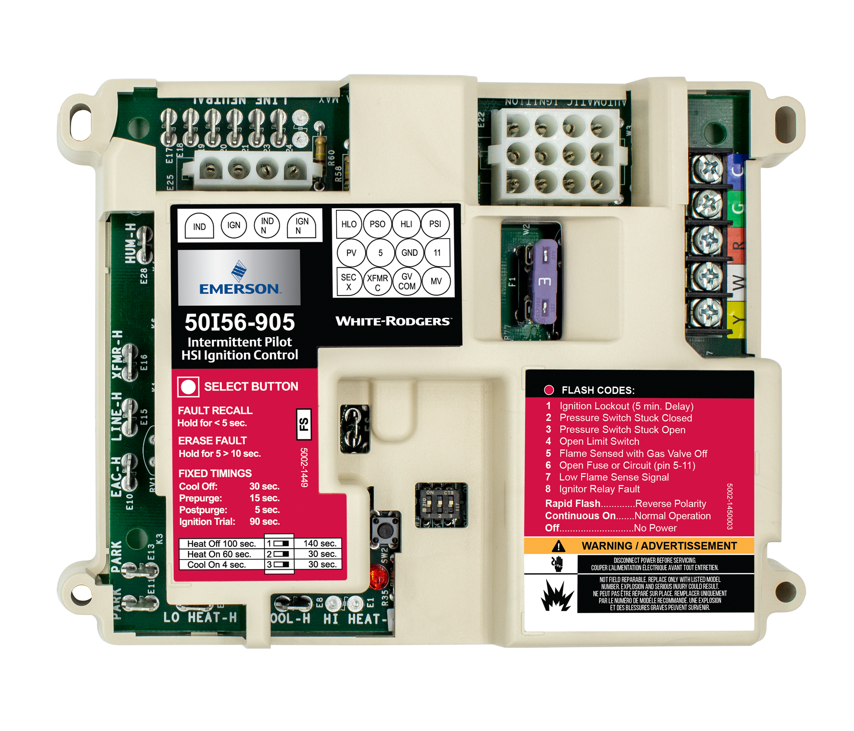
White-Rodgers 50I56D-905
Retrofit Kit IFC Components
120v Components:
6 120v Neutral Spades
4-Pin 120v Inducer / Ignitor Molex Connector
120v Humidifier Spade
120v to Transformer Spade
120v Hot Input Spade
120v EAC Spade
2 Extra Blower Speed Park Spades
PSC Blower Heat Spade
PSC Blower Cool Spade
24v Components:
12-Pin 24v Wiring Molex Connector
24v Thermostat Bus​
3a Low Voltage Fuse
Other Components:
Flame Sense 3/16” Spade
Blower Delay Dipswitches
Fault Recall Button
Status / Fault LED
Mounting Holes
17
1
17
10
2
3
11
12
4
5
13
14
6
15
7
16
17
17
8
9
50I56D-905
Retrofit Kit IFC

Slide 13
Intelligent Valve Retrofit Kit Benefit Summary
Simple Parts
Easy to Follow Instructions
Lower Cost
The 50I56D-905
utilizes common parts
to retrofit furnaces with complex gas with hot surface ignition, making troubleshooting much easier.
Step-by-step instructions offer a seamless installation experience.
A QR Code on the box offers a complete installation video.
The complete 50I56D-905 retrofit kit is priced competitively, allowing you to purchase an Integrated Furnace Control, Gas Valve, & 120v Ignitor for less than a replacement valve alone in most cases.

Slide 14
50I56D-905 Competitive Comparison
White-Rodgers simplifies the SmartValve replacement process.
FEATURE | Honeywell | White Rodgers
Stocking Requirement | Hard – Three or Four Separate Parts | Easy - One Complete Kit
Warranty | 1 Year | 5 Years
Ignitor Technology | 24V Ceramic Composite | 120V Nitride
Gas Valve Technology | Complex Integrated Electronics | Reliable Standard Mechanical
Intermittent Pilot System Operation | ✔ | ✔
Fault Recall & Pushbutton | ✘ | ✔
Troubleshooting | Hard - Specialized Parts & Training | Easy - Like Most Standard Furnaces
Dipswitch Selectable OEM Blower Delays | ✔ | ✔
Main Board with Full Cover & Fault Code Label | ✘ | ✔

Slide 15
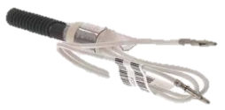
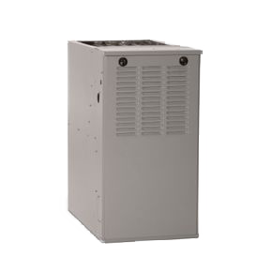
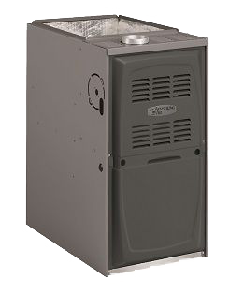
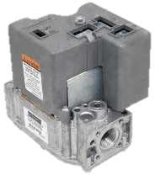

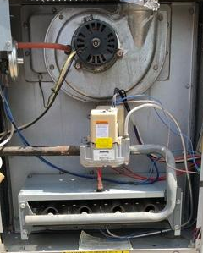
SmartValve History
1969
1987
1995
1994
2006
Era of Gas Valves w/ Electronics Manufactured in Furnaces
The National Appliance Energy Conservation Act set a minimum of 78% Annual Fuel Utilization Efficiency (AFUE)
Manufactures stop building furnaces with standing pilot light ignition systems
The birth of HSI: Carborundum Co. makes 1st Silicon Carbide ignitor
ICP begins manufacturing furnaces using a Gas Valve with a circuit board to operate a 24v Ceramic Composite Hot Surface Ignitor.
Lennox uses the Armstrong line to follow suit in building Furnaces using the SmartValve & Fan Timer module.
Furnaces with non-integrated controls no longer manufactured
ICP produced >3M furnaces from 1994 to 2006. During this period they manufactured Furnaces using a Fan Timer Control and SmartValve®.
Brands that used the SV System
Notes:
Annual board sales still estimated at 80k-100k
Main users w/ the SmartValve were ICP, Lennox (Armstrong, Ducane), and York (Coleman/Evecon)

Slide 16
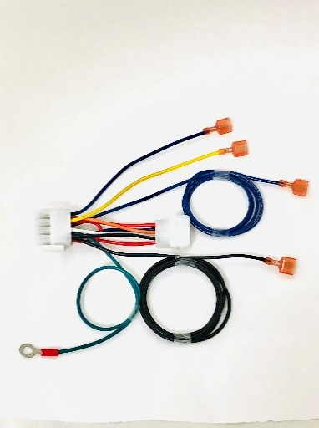
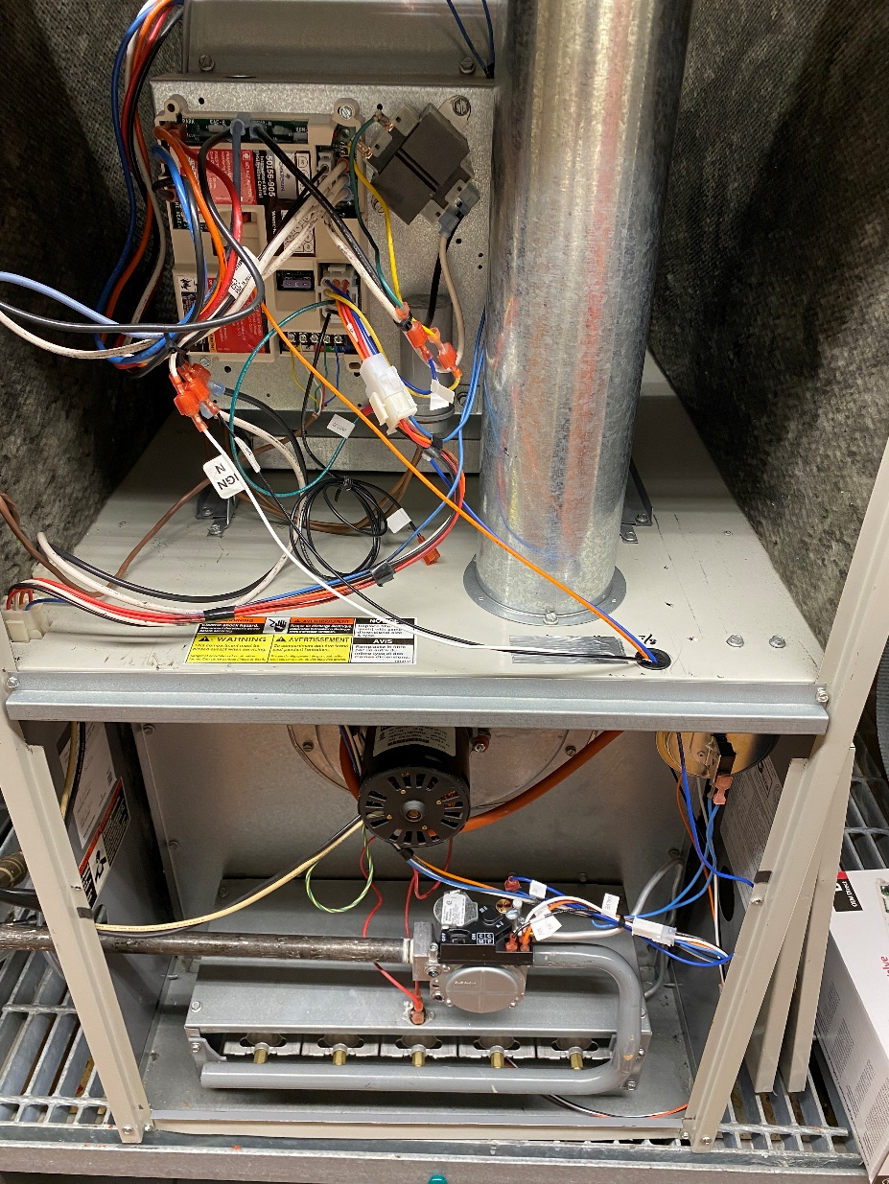
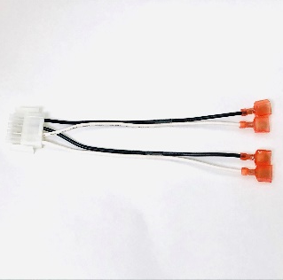
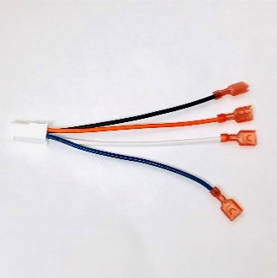

Wiring the Intelligent Valve Retrofit Kit
ICP & Lennox use a harness with a 6-pin Molex that connects to the Fan Module, and a 4-pin plug that connects to the SmartValve®
The White-Rodgers Kit comes with two adapters that connect the existing furnace harness to a standard IFC & Gas Valve.
We also include a harness to connect the 120v Inducer and the 120v Hot Surface Ignitor.
Control Harness
Ignitor/Inducer Harness
Valve Harness
1
2
3
TECH TIP: White-Rodgers simplifies Retrofitting by using the existing Main Furnace Harness.

Slide 17
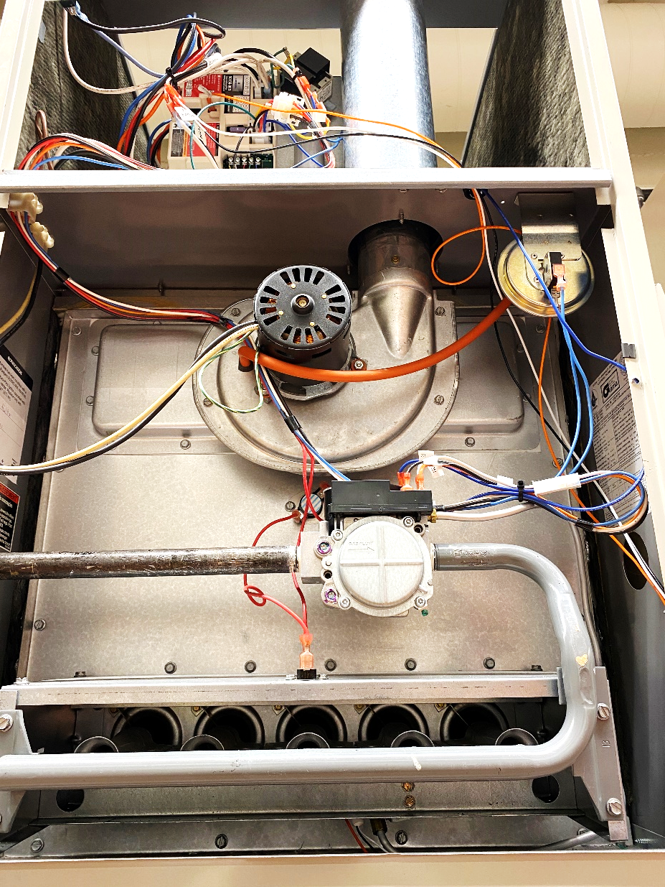
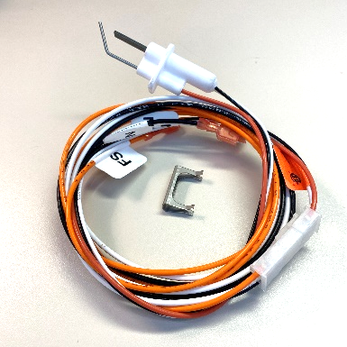
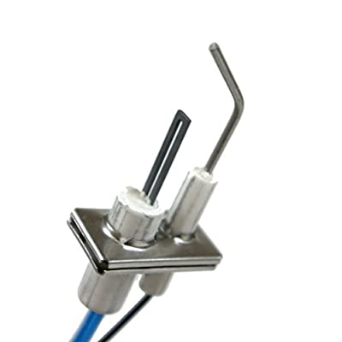
Upgrading to 120V Hot Surface Ignition
In SmartValve systems, the HSI relies on 24v from the valve to heat the ignitor. These ceramic ignitors will often fail, due to comparably poor materials.
We include a 120v Nitride Ignitor in our kit that matches the size & shape of the existing ignitor, and has a factory installed harness that runs to the blower area and connects to the IFC through the “C” Harness.
24v

Slide 18
Specs
ELECTRICAL RATING
Input Low Voltage: 25 VAC, 60 Hz
Input Line Voltage: 120 VAC, 60 Hz
Max Input Current: .45A @ 25 VAC
FLAME CURRENT REQUIREMENTS:
Minimum current to ensure flame detection: 0.25 μA DC*
Maximum current for non-detection: 0.1 μA DC
Maximum allowable leakage resistance: 100 M ohms
* Measuring with a DC voltmeter (1VDC = 1 μA)
RELAY CONTACT RATINGS:
Inducer Output: 2.2 FLA @ 120 VAC 3.5 LRA
Blower Output: 14.5 FLA @ 120 VAC 25 LRA
Gas Valve Output: 1.5A @ 25 VAC 0.6 pf
Ignitor Output: 6.0A @ 120VAC (resistive)
Hum and EAC Load: 1.0A @ 120 VAC
OPERATING TEMPERATURE RANGE:
-40° to 176°F (-40° to 80°C)
HUMIDITY RANGE:
5 to 95% relative humidity (non-condensing)
50I56D-905
CROSS REFERENCE ON THE BOX

Slide 19
Install

Slide 20
White-Rodgers Intelligent Valve Retrofit Kit
The White-Rodgers 50I56D-905 Intelligent Valve Retrofit Kit converts furnaces built with a SmartValve® and Fan Timer to operate with a standard intermittent pilot valve and integrated furnace control, and replaces over 50 first generation SmartValve® controls.
Applications:
Single Stage Gas Heat
PSC Blower Motor
Upgrade 24v HSI ignitor to 120v
Intermittent Pilot Operation
ICP & Lennox Brands
1st Gen SmartValve Retrofit
50I56D-905

Slide 21
What’s in the Box?
50I56-905 120V HSI IP Furnace Control Board
1 - Main CONTROL Harness
1 - Gas VALVE Harness
1 - Ignitor/Inducer C Harness
1 - 120V Ignitor + Flame Sensor Kit for Pilot Assembly
1 - 36G33-905 IP Gas Valve w/ LP Conversion kit
4 - 1” Sheet Metal Mounting Screws
4 - Wire Ties
2 - 1/4" Female Crimp-on Spades
2 - 7/8” Sheet Metal Wire Grommets
Unit Retrofit Label
Installation Instructions
Troubleshooting Label on Control Cover
50I56D-905

Slide 22
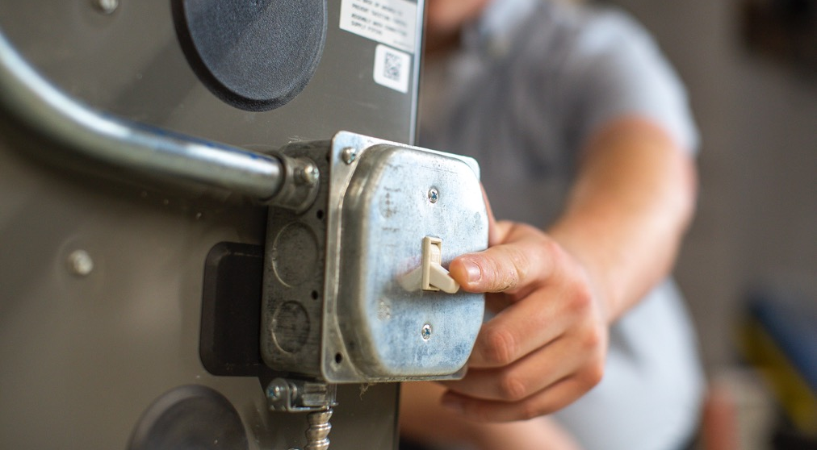
Disconnect Power and Gas
1
First, ensure power and gas are disconnected prior to servicing the unit.

Slide 23
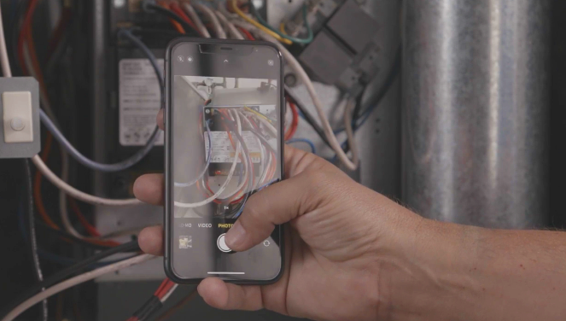
Take a Picture of Wiring
2
Remove access panels and take pictures before removing any wiring. Label existing wiring as necessary.

Slide 24
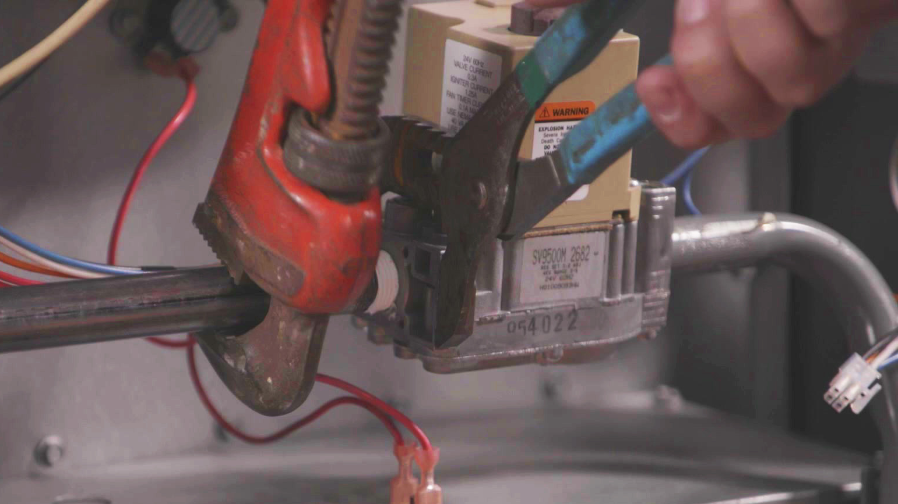
Remove Parts to Prepare for Retrofit
3
Disconnect both 4-pin plugs and pilot tubing, remove gas valve and discard.

Slide 25
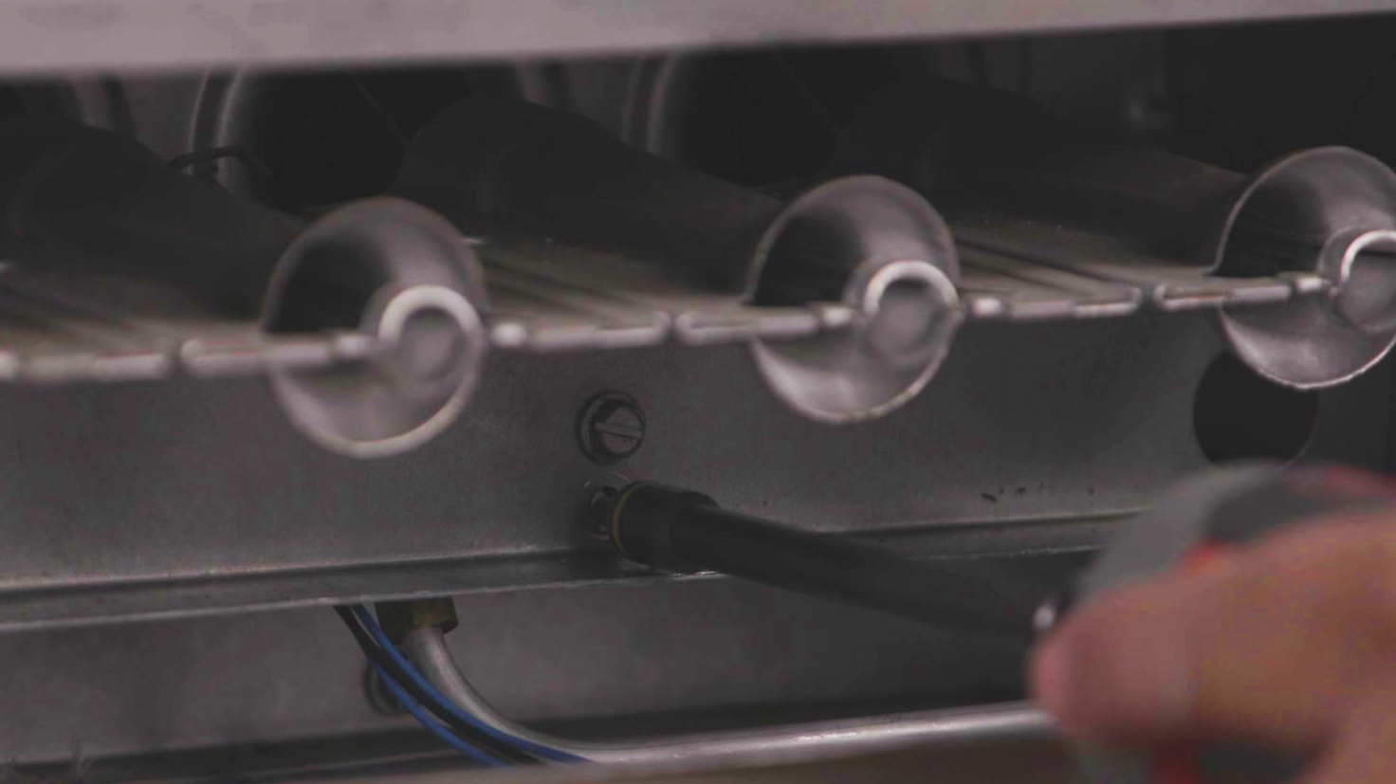
Disconnect Pilot Assembly
4
Remove 24V HSI ignitor + sensor and clip from assembly. NOTE: Discard existing 24V ignitor + sensor and clip. Use new clip for best fit.

Slide 26
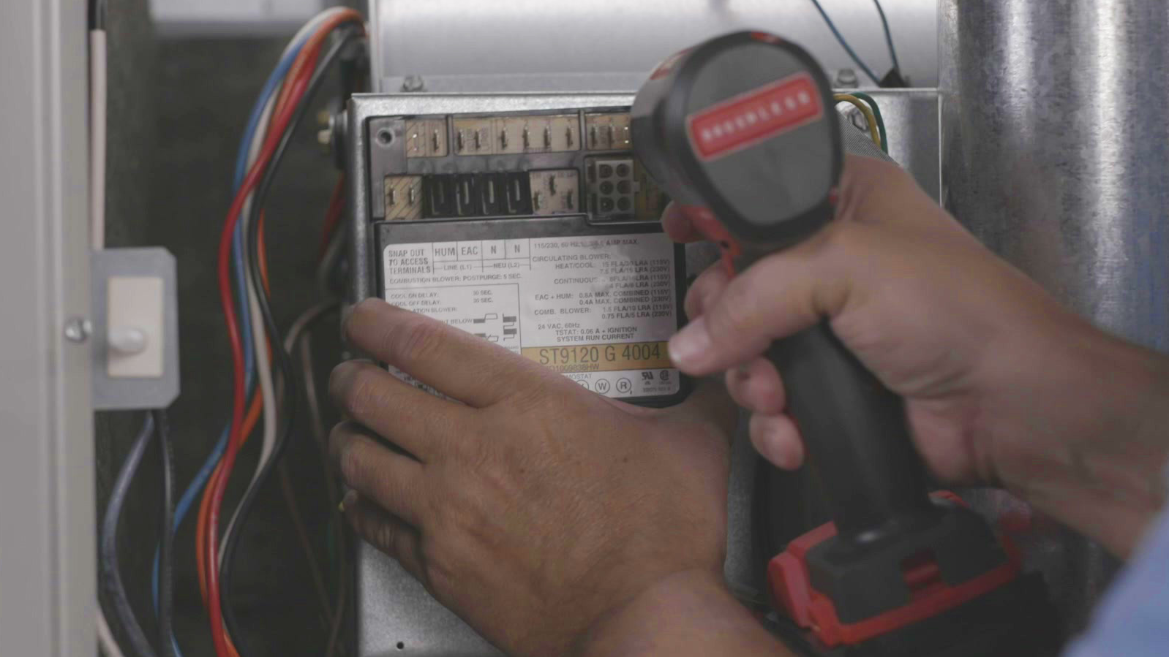
Disconnect Fan Timer
5
Unwire fan timer, remove & discard

Slide 27
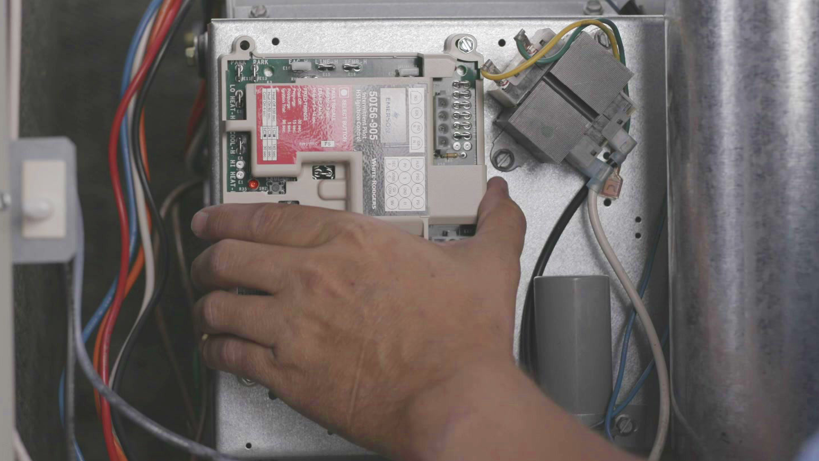
Retrofit New Parts into Furnace
1
Mount 50I56-905 control in blower area using cover as drill template and using 4" x 1" screws.
Warning: Avoid damaging components when drilling or driving screws. All wiring should be installed according to local and national code.

Slide 28
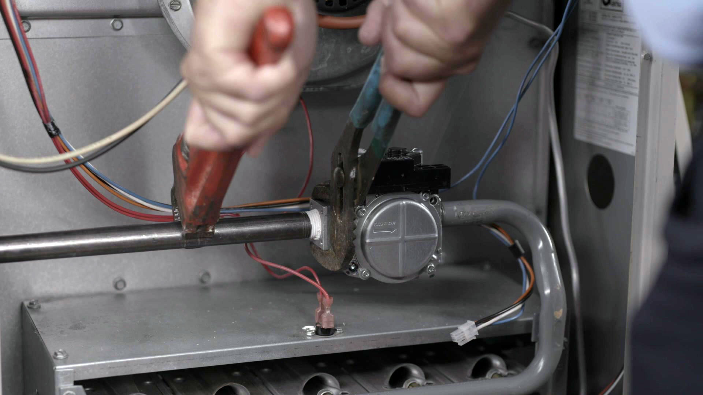
Install Gas Valve
2
Install 36G33-905 gas valve in furnace. See instructions in box.

Slide 29
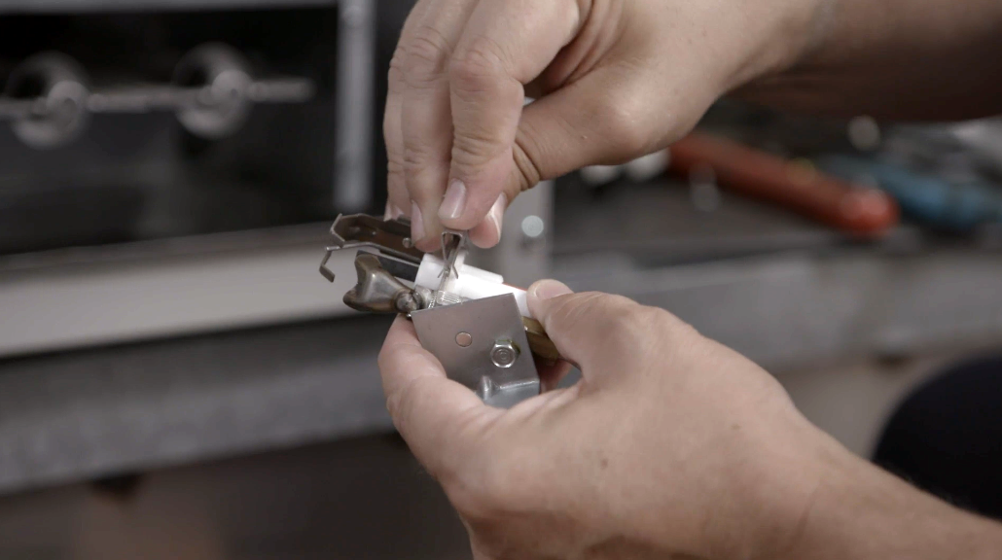
Install Ignitor + Sensor
3
Install 791Q-905 120V HSI Ignitor + sensor into pilot assembly using new clip for best fit. Reinstall pilot assembly and connect gas supply tubing to new gas valve.

Slide 30
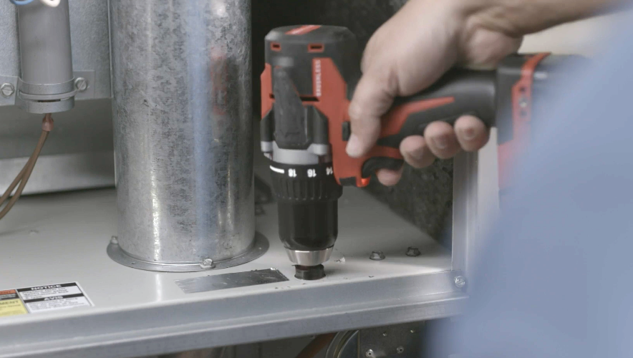
Wire Passage
4
Locate an existing wire passage between the burner and blower areas or drill 7/8" hole(s) and install wire grommet(s). NOTE: Some new wiring such as ignitor + sensor, pressure switch, and MV wire (Armstrong) will be run from the burner area to the blower control board area.

Slide 31
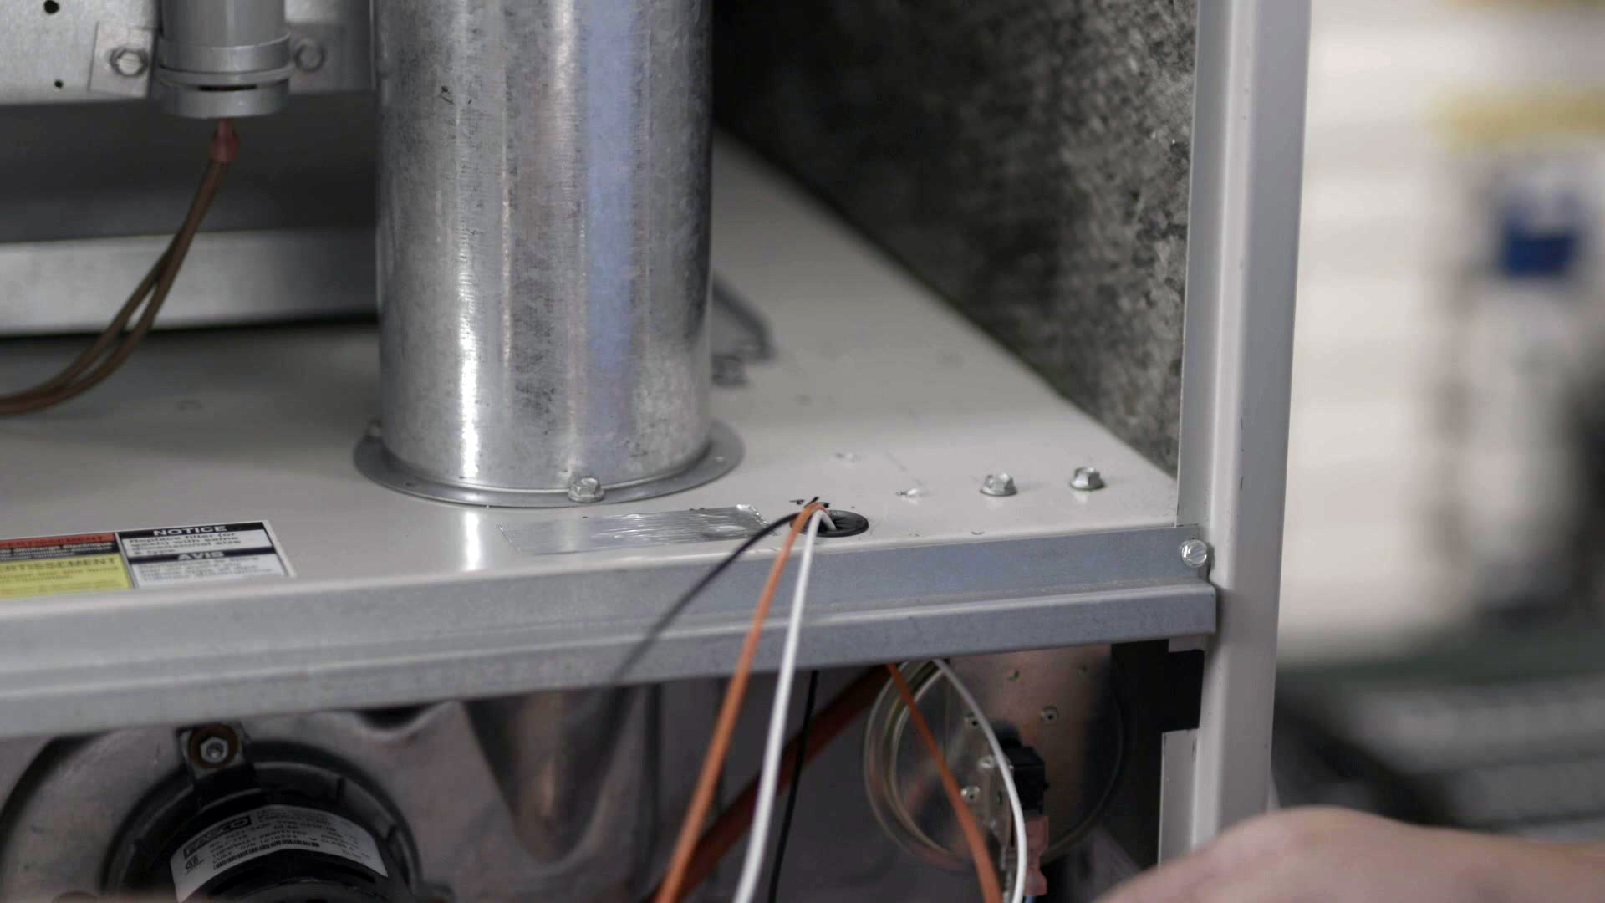
Extension Harness
5
Route 3-pin EXTENSION harness connected to the ignitor + sensor wires from burner area to blower control board area.
Add extension harness photo

Slide 32
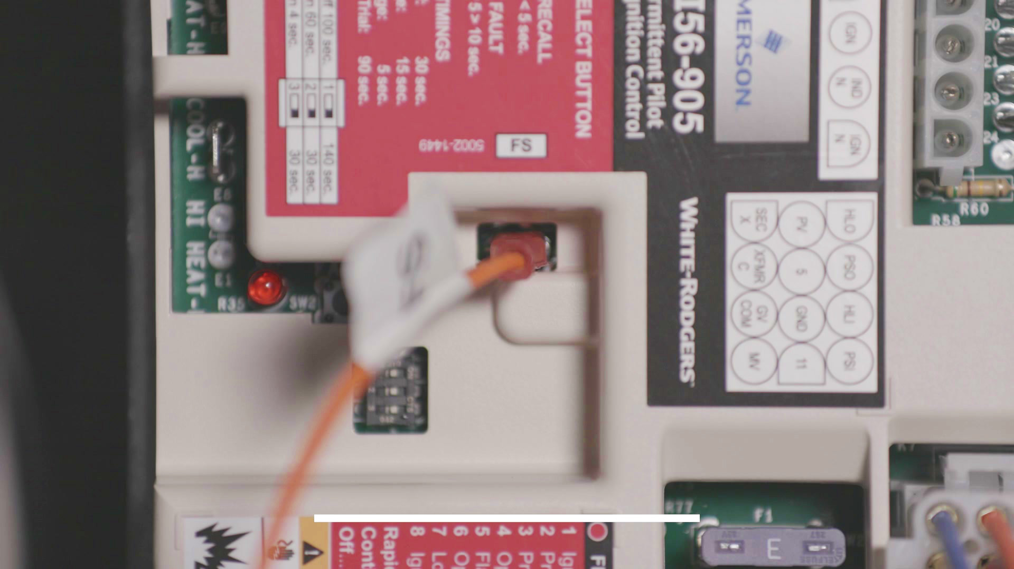
Connect Flame Sensor
6
Plug orange flame sensor wire onto control board 3/16” FS spade, see page 4 of the Install Guide.

Slide 33
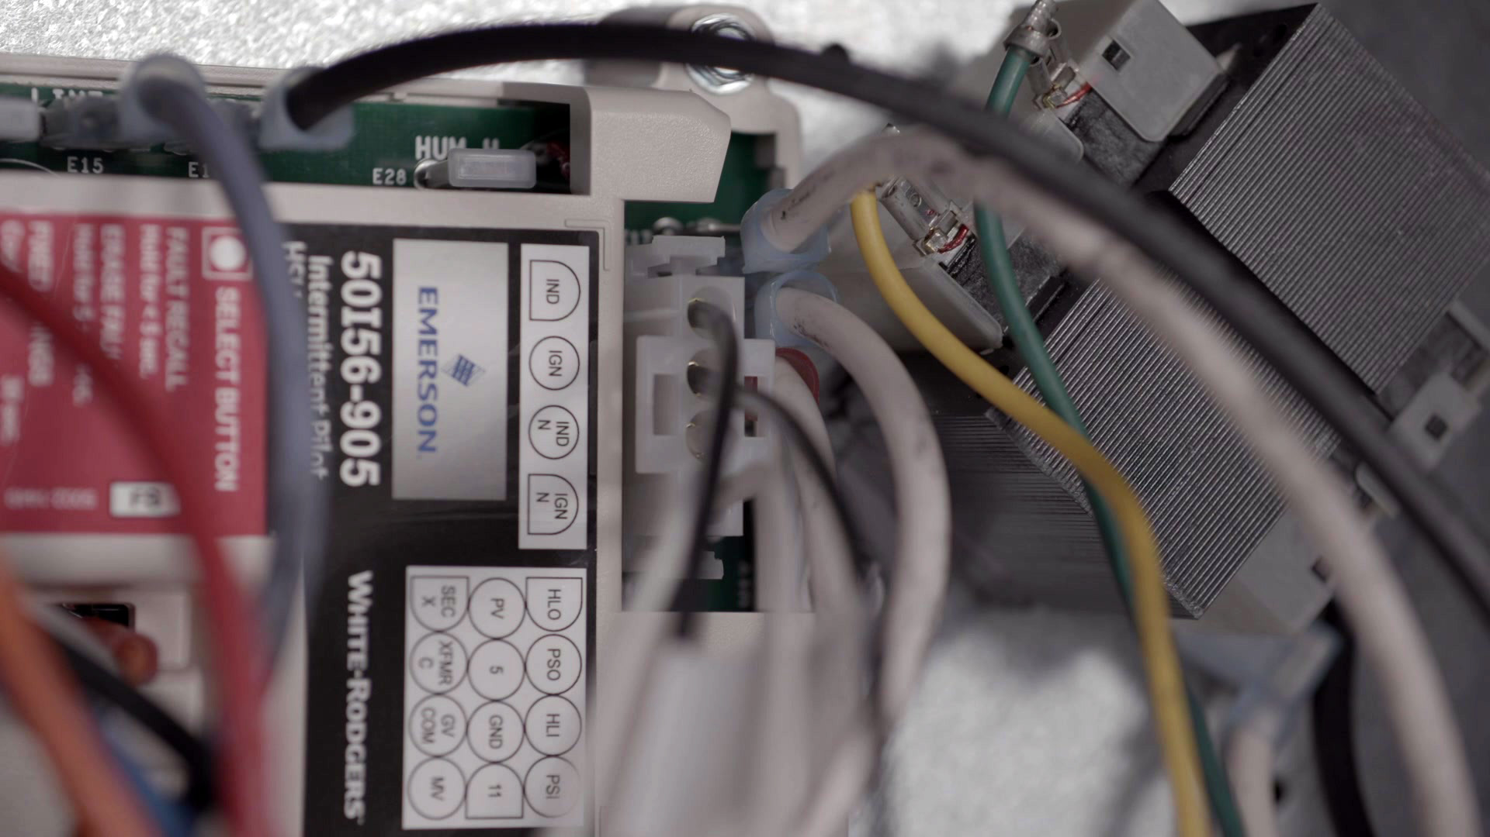
Connect C Harness
7
Plug 4-pin Ignitor/Inducer C harness into control board connector E25, see page 4 of the Install Guide.

Slide 34
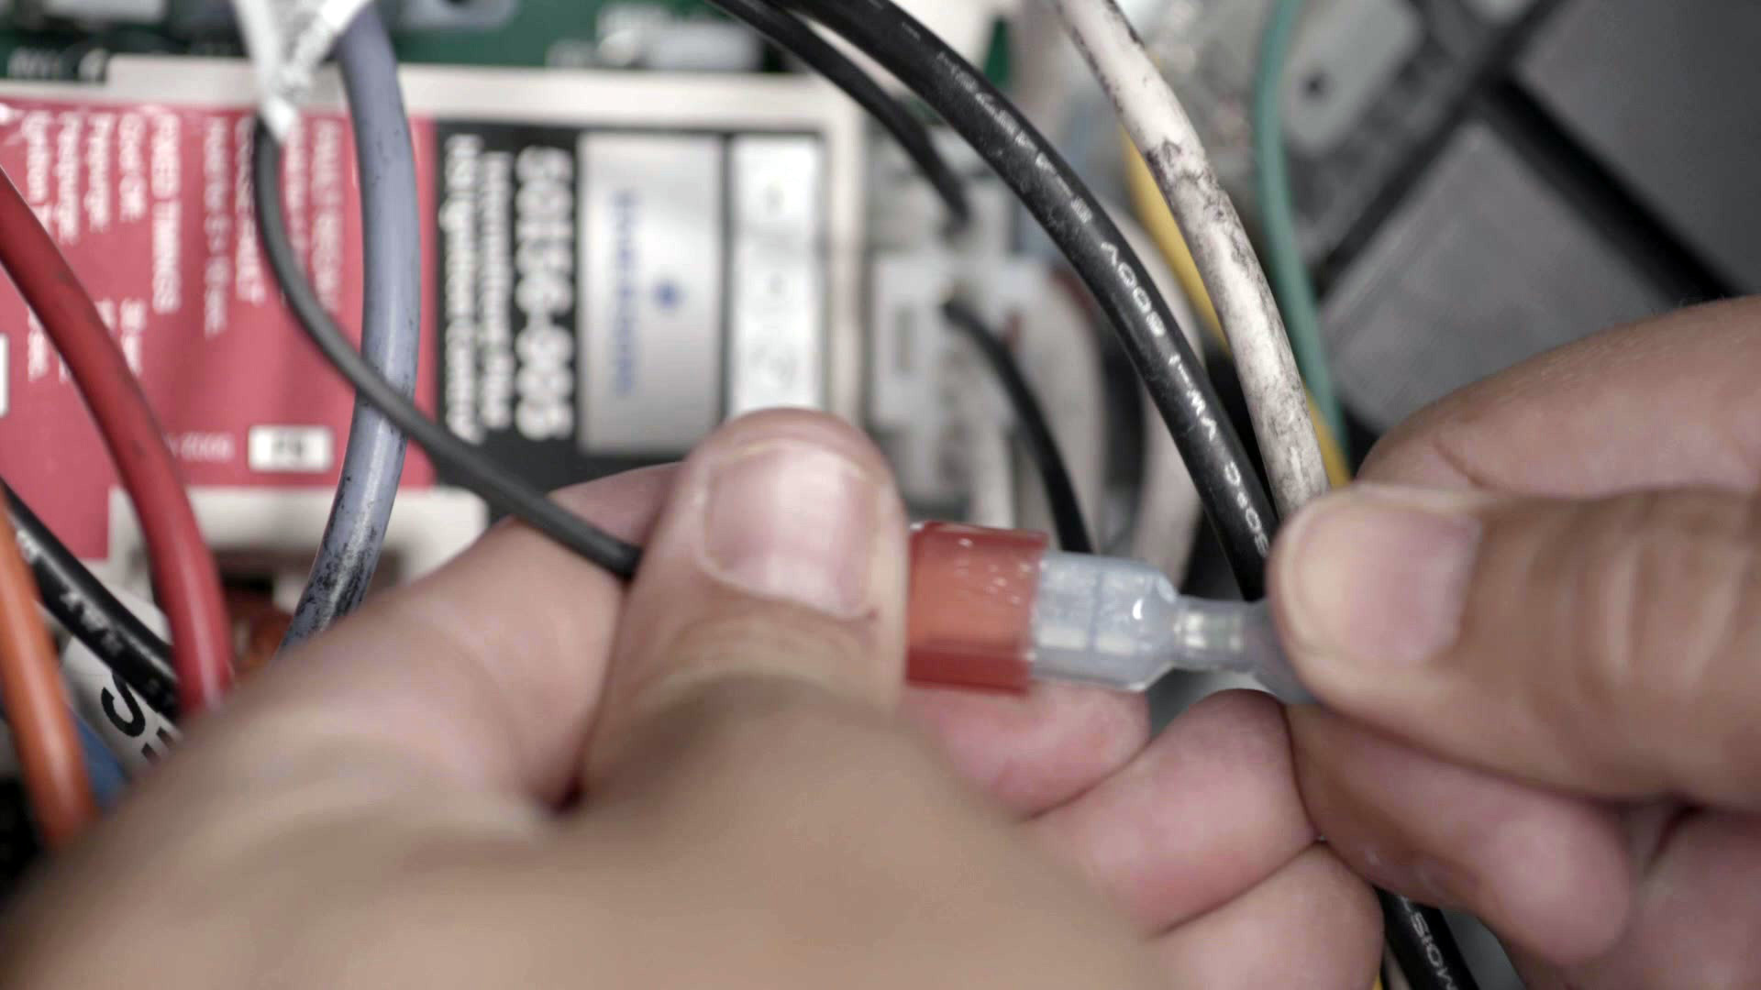
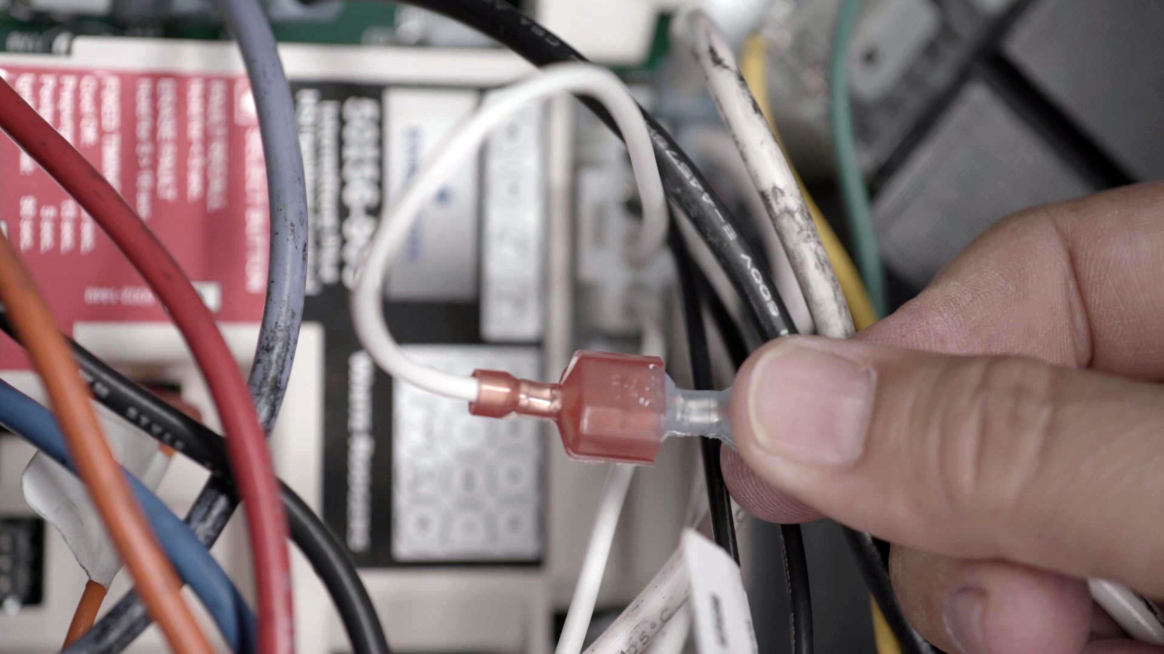
Connect Ignitor and Inducer Wires
8
Connect Ignitor hot (IGN) and neutral (IGN N) from EXTENSION harness to C harness leads 2 & 4, see control board label.
9
Connect Inducer hot (IND) and neutral (IND N) to C harness leads 1 & 3, see control board label.

Slide 35
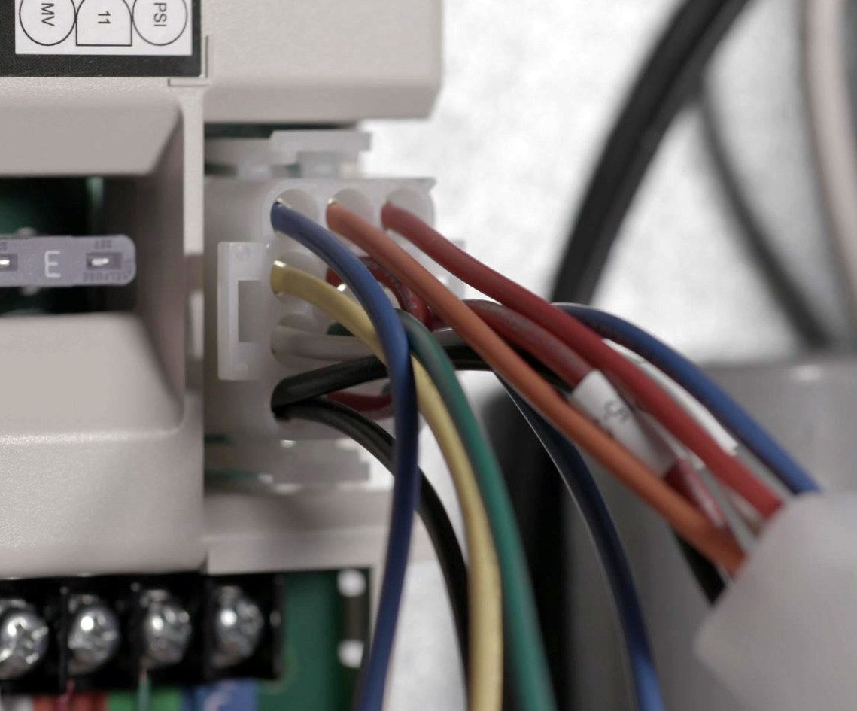
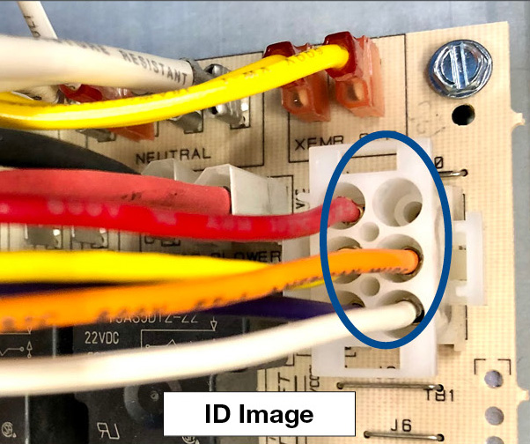
Continue Connecting Wires
10
Plug main CONTROL harness into control board 12-pin connector E22, see page 4 of the Install Guide.
Route blue PS pressure switch wire from control board to burner area.
Connect green GROUND wire to chassis.
For Armstrong (or similarly wired units – see ID IMAGE below), route black MV* wire from control board to burner area and read NOTE below.
NOTE: Armstrong MV* / High Limit Wiring: See page 5 of the Install Guide, Special Replacement Instructions, to complete MV* wiring from STEP 9

Slide 36
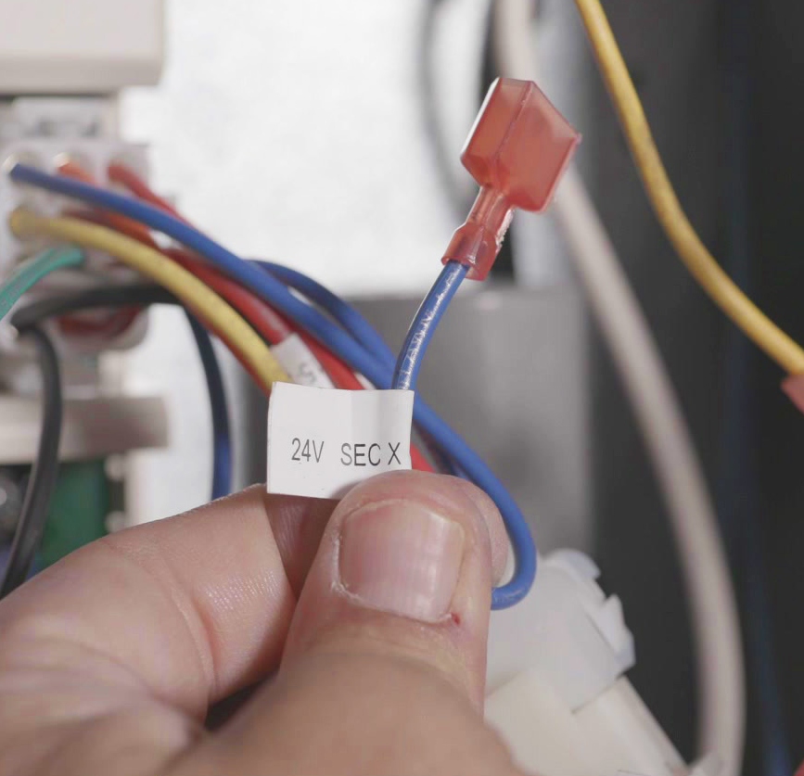
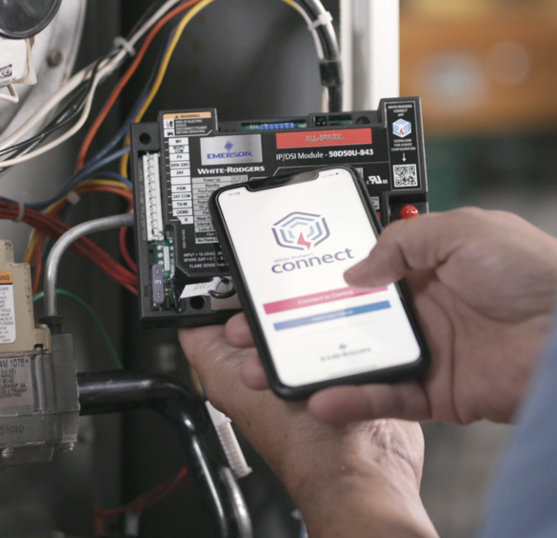
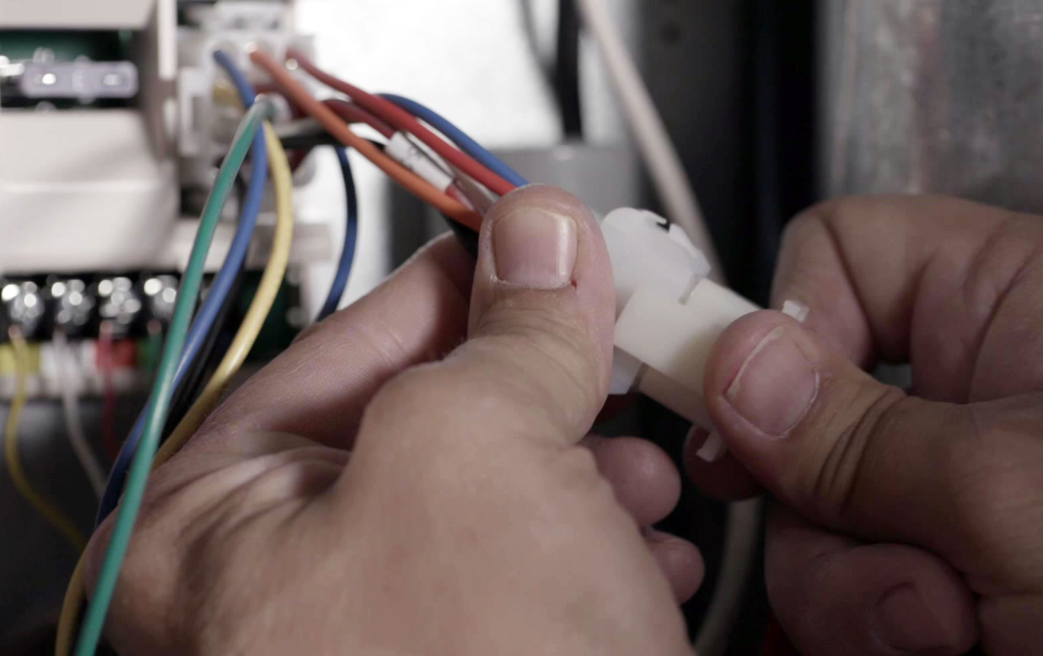
Continue Connecting Wires
11
Connect transformer to CONTROL harness.
Secondary to blue 24V SEC X wire.
Common to yellow 24V XFMR C wire.
12
Connect OEM factory wiring 6-pin plug into CONTROL harness.

Slide 37
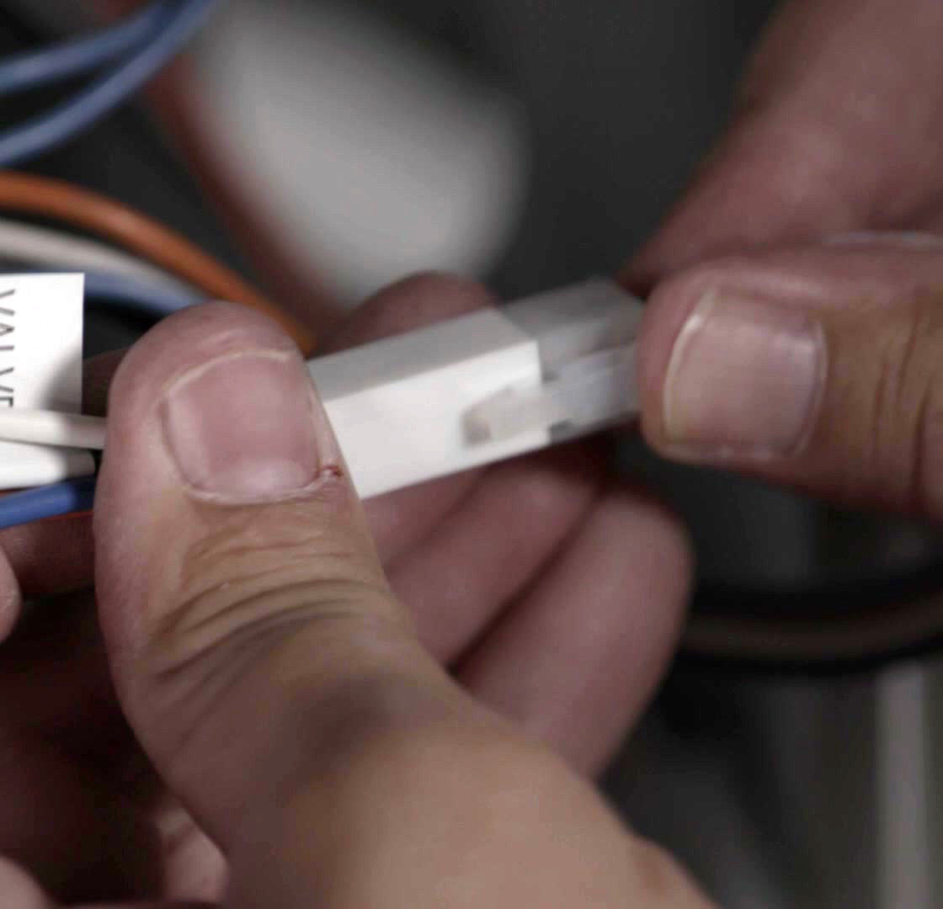
Connect Valve Harness
13
Plug 4-pin VALVE harness into factory 4-pin square plug removed from gas valve.
Connect black MV harness spade to gas valve M terminal.
Connect orange PV harness spade to gas valve P terminal.
Connect white COM harness spade to gas valve C terminal.

Slide 38
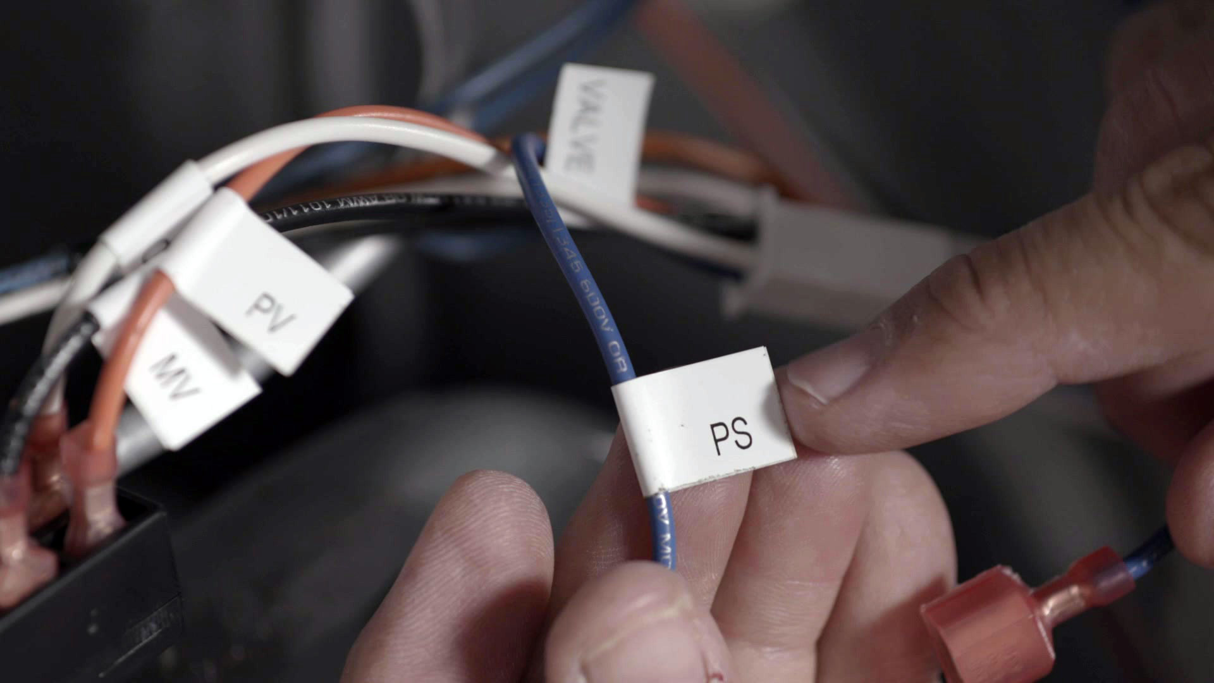
Continue Connecting Valve Harness
14
Connect blue PS wire previously routed from CONTROL board harness to burner area to PS spade of VALVE harness.

Slide 39
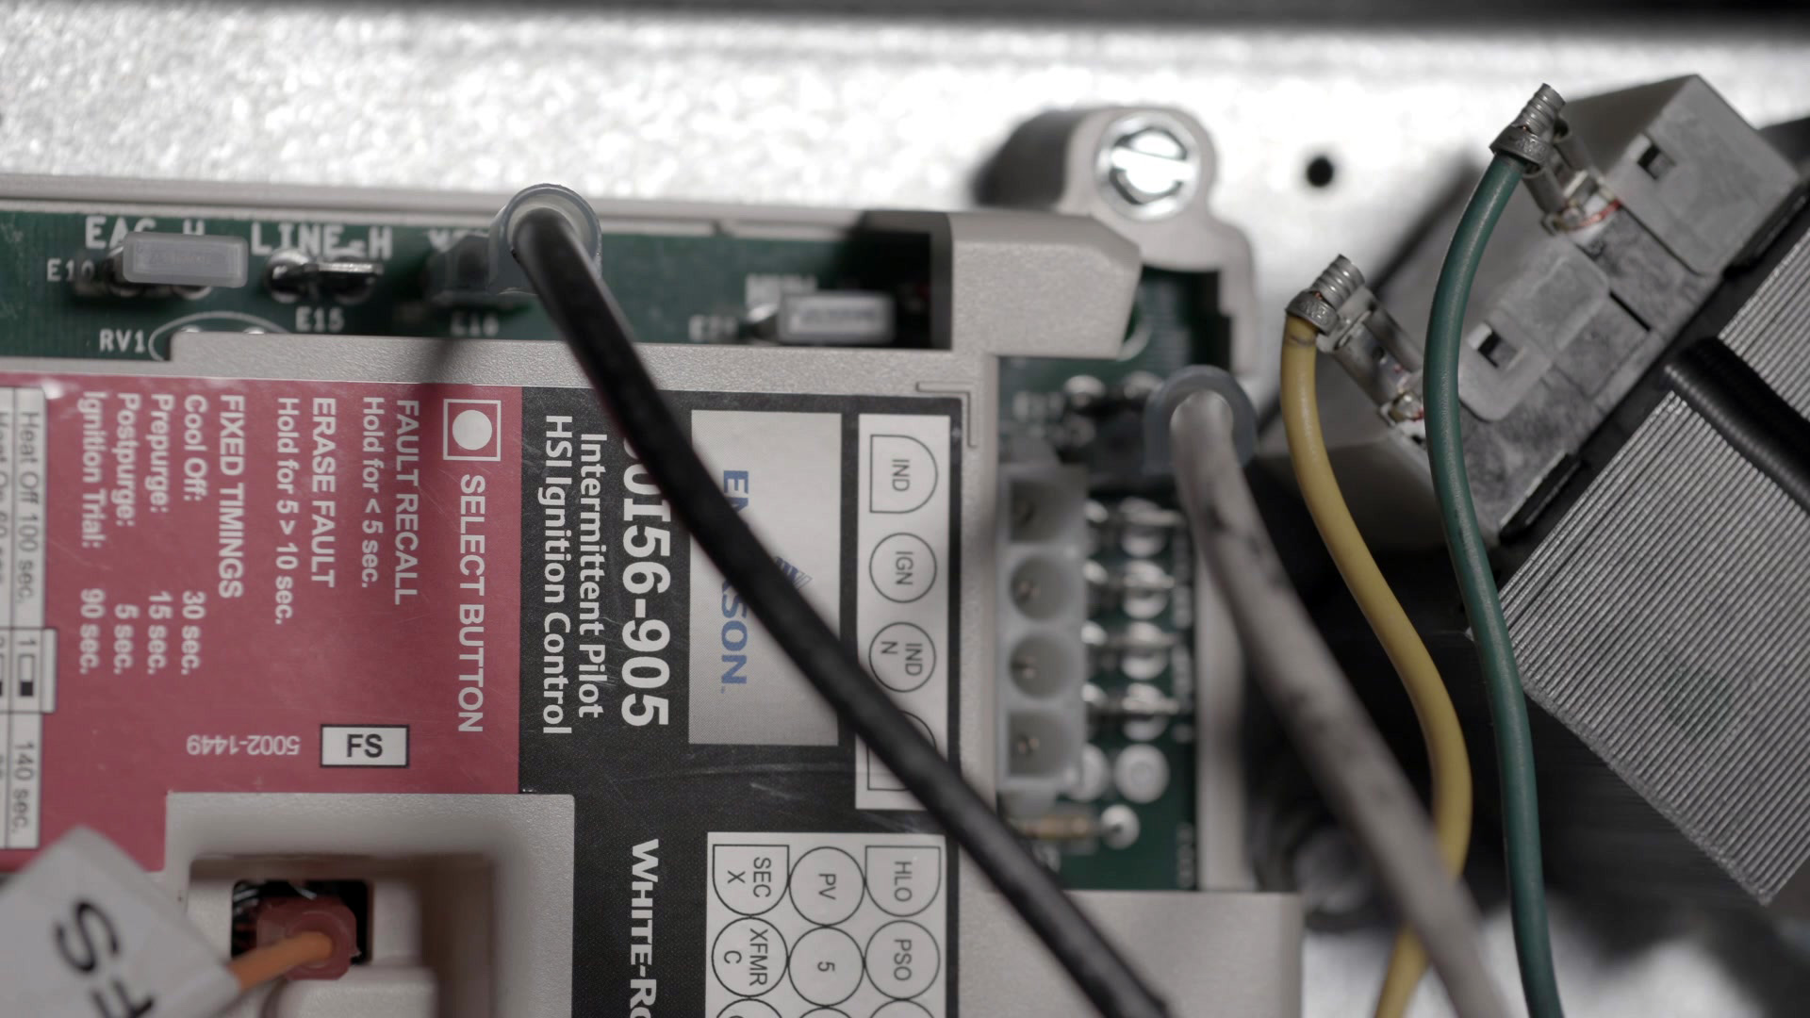
Connect Transformer
15
Connect transformer hot to XFMR-H, then connect transformer neutral to LINE NEUTRAL.

Slide 40
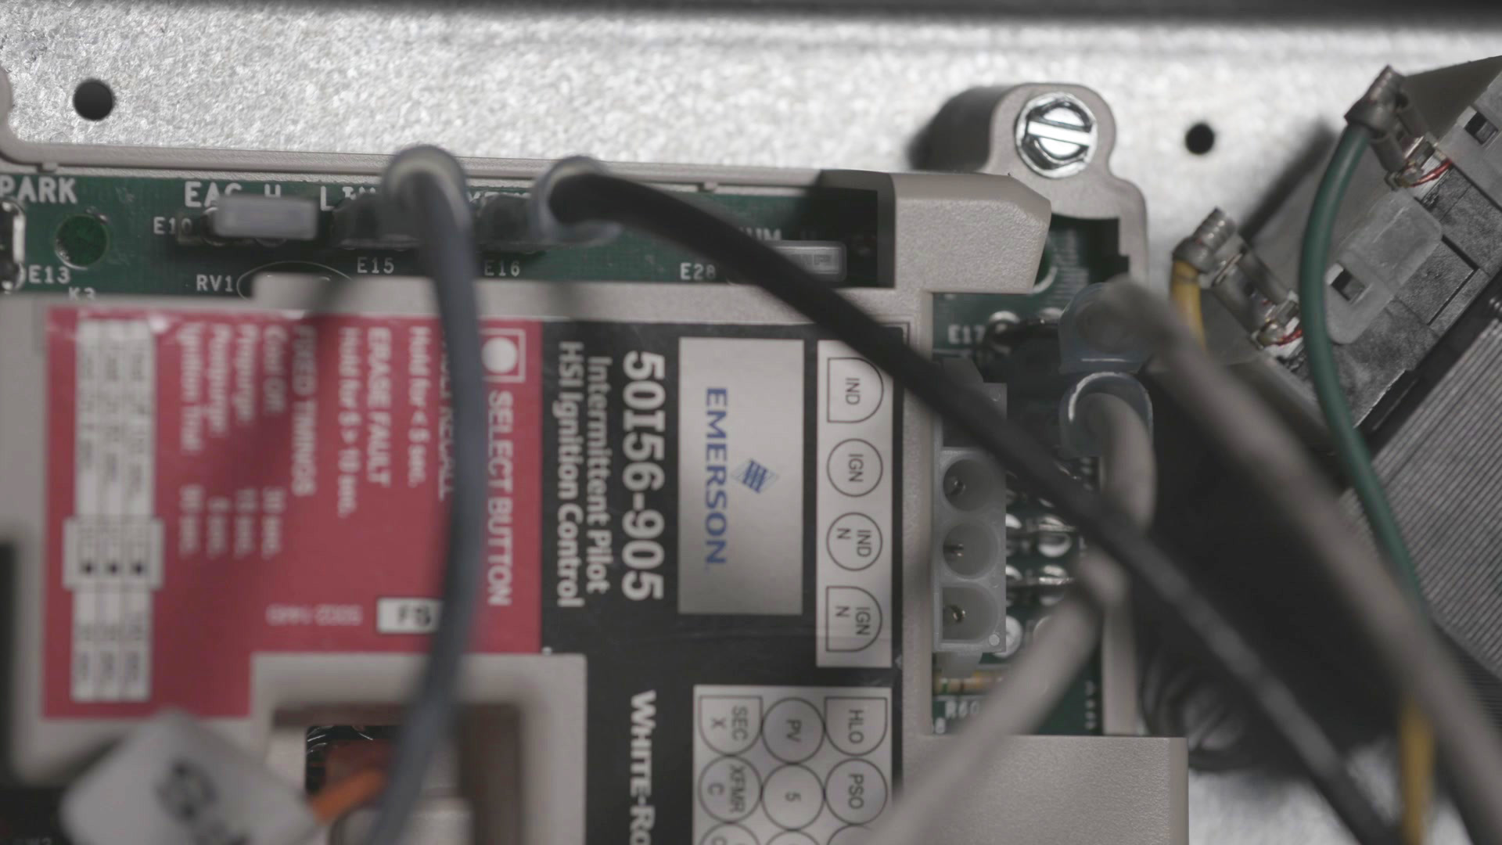
Connect Line Voltage
16
Connect line voltage hot to LINE-H, then connect LINE NEUTRAL.

Slide 41
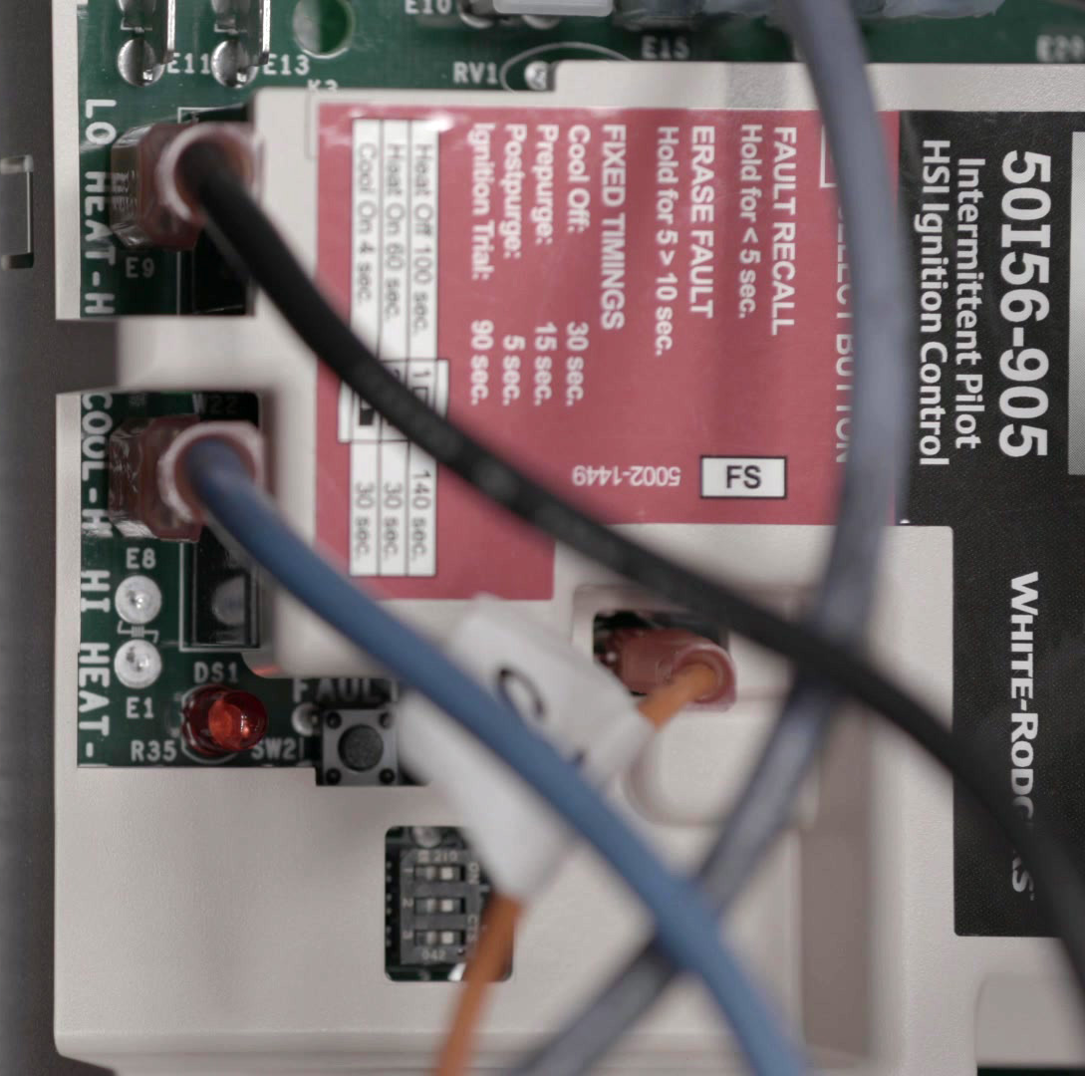
Connect Blower Leads
17
Cool speed to COOL-H
Heat speed to LO HEAT-H
Unused leads on PARK, PARK
Neutral to LINE NEUTRAL

Slide 42
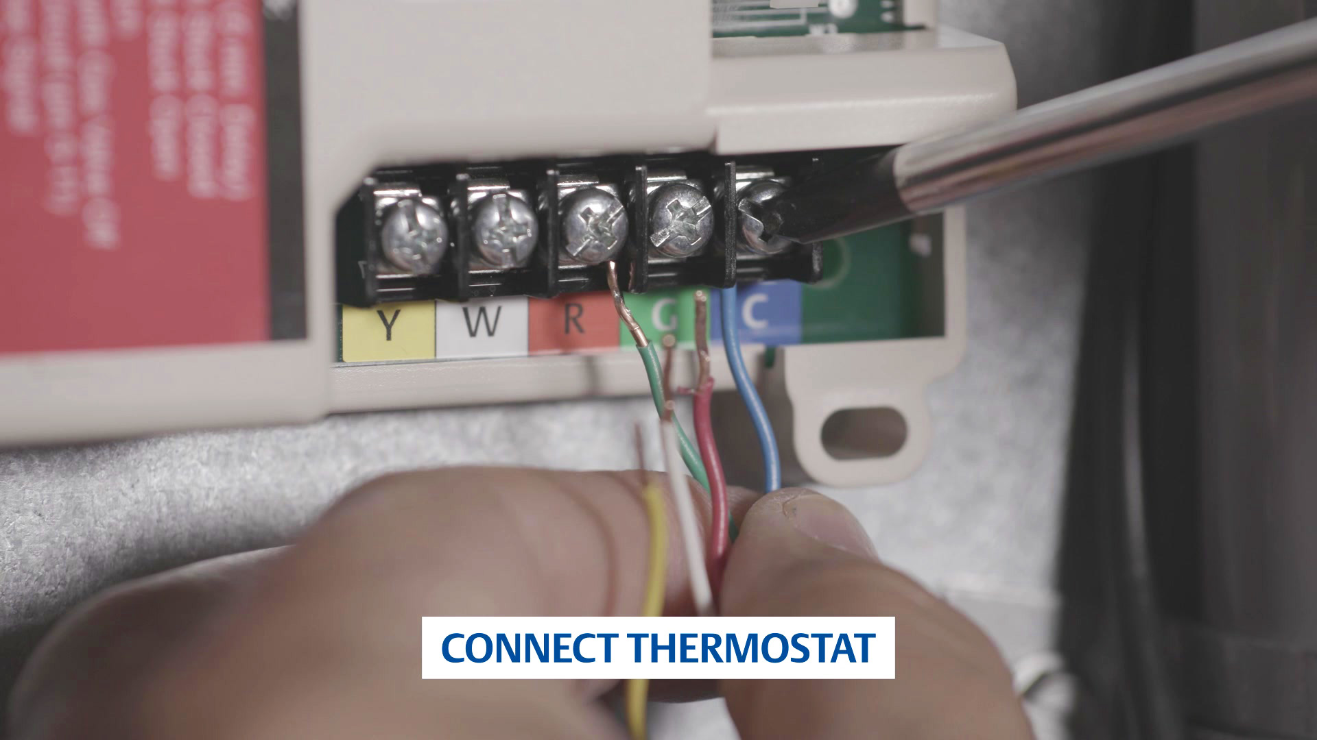
Connect Thermostat Wires
18
Connect thermostat wires to screw terminal block.
Cut that subhead below

Slide 43
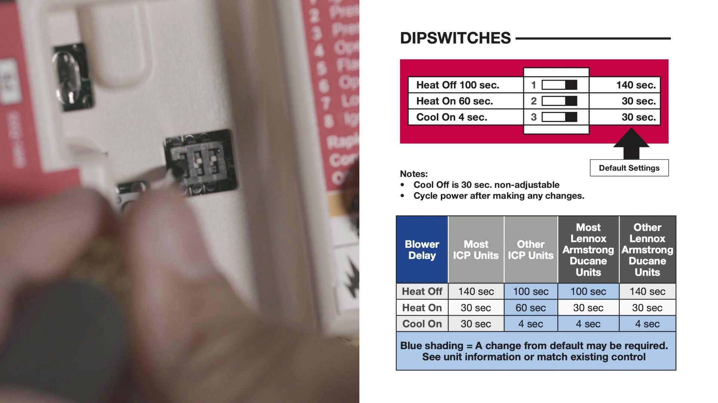
Dipswitch Settings
19
Verify dipswitch setting using cover label and DIPSWITCHES section below.

Slide 44
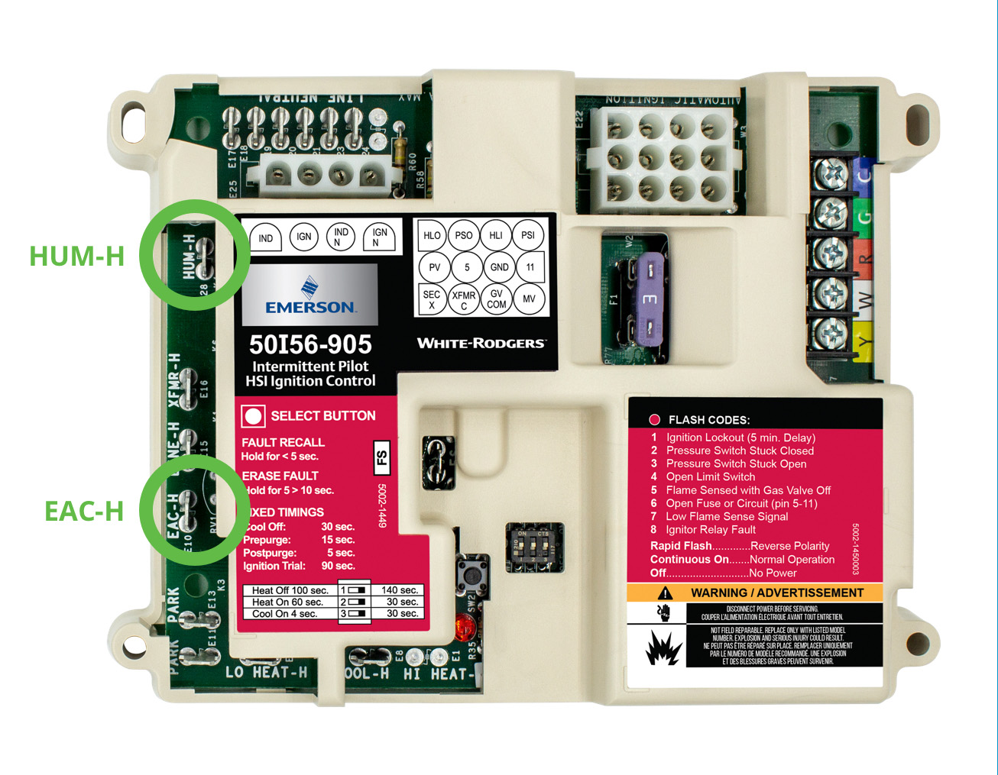
Optional Connections
20
Option - connect 120V humidifier to HUM-H and LINE NEUTRAL.
Option - connect 120V EAC to EAC-H and LINE NEUTRAL.

Slide 45

Secure Wiring
21
Apply wire ties as needed to secure wiring and install Unit Retrofit label. Reinstall access panels, reconnect gas supply and electric power.

Slide 46
Reconnect Gas and Power
22
Reinstall access panels, reconnect gas supply and electric power.

Slide 47


Verify
23
Test the Gas Valve using the instructions supplied with the Gas Valve.
Verify unit operation in HEAT, COOL, and FAN modes.
NOTE: See Wiring Diagrams, Timings & Wiring Designators, and Operation sections for additional details

Slide 48

Troubleshooting
FAULT RECALL
When the control is in Standby mode (no call for heat or cool), press the SELECT button for approximately 2 to 5 seconds or until the diagnostic LED turns off. Up to 5 fault codes are stored. NOTE: While displaying the stored fault codes, the control will ignore any new call for heat, cool or fan.
FAULT CODE ERASE & RESET
When the control is in Standby mode (no call for heat or cool), press the SELECT button for 5 to 10 seconds or until the diagnostic LED begins to rapid flash.
NOTE: If the button is pressed for over 10 seconds the rapid flash will stop and the control will return to Standby.

Slide 49
Troubleshooting Continued
CONTROL LOCKOUT RESET
Remove 24 VAC power to the control for greater than 10 seconds to reset. An example would be to reset & troubleshoot a unit with flash code 1 that is in a 5-min. lockout / delay.
R-5386

